Slide 1
CS4104
Applied Machine Learning
Lecture No 1
Introduction
Spring 2025
1

Slide 2
Contact Information
Dr. Kashif Zafar
kashif.zafar@nu.edu.pk
Office: New Building - FSC
Phone: 042-111 128 128 Ext: 569
Office hours: Monday 2:30 – 4:00 pm
Wednesday 2:30 – 4:00 pm
Lectures available on: Google Classroom
Tools & Languages: Matlab, WEKA, and Python Language

Slide 3
Grading Policy
Quiz 10
Assign 10
Mid I 15
Mid II 15
Project 10
Final 40
----------------------------------
Total = 100

Slide 4
Term Project
Submission of 1-2 pages Proposal with project title, group info, contact details, abstract, tentative /algorithms or tools, outcome or deliverables, references
Due Date: February 10, 2025, before 4:00 pm [Hardcopy & Soft copy]
Submission of Mid Evaluation Report (March 17, 2025 - before 4:00 pm)
Demo and Final Report submission [Problem formulation, existing solutions, proposed solution/methodology/framework, implementation/experiments, results, conclusion, references] will be held in the last week of semester
2-3 students in a group
Final submission and demo/presentation in second last week of semester.
You can select from the Term Project’s List, Kaggle or https://www.profillic.com/ etc.,

Slide 5
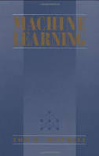
Books & Resources
Text/Reference Book:
Machine Learning by
Tom Mitchell
Slides will be provided through Google classroom

Slide 6
Tentative Course Outline
Introduction to Machine Learning
Supervised and Unsupervised learning
Decision Tree
Random Forest
Perceptron learning rule
Gradient Descent
Neural Network
SVM
KNN
Evaluation Metrics
Regression
Linear and Non-Linear Regression
Logistic Regression
Clustering
kmeans
kmediods
Agglomerative (AGNUS)
Bayes’ theorem and Naïve Bayes (TBD)
Advanced Topics

Slide 7
Tentative Course Outline
• Supervised learning
– Decision tree induction
– Linear regression
– Logistic regression
– Support vector machines
& kernel methods
– Model ensembles
– Neural networks &
Deep learning
• Unsupervised learning
– Clustering
– Dimensionality reduction
• Reinforcement learning
– Temporal difference
learning
– Q learning
Evaluation metrics
• Advanced Topics

Slide 8
What is Machine Learning?
The field of machine learning is concerned with the question of how to construct computer programs that automatically improve with experience.
(Tom Mitchell)
Principles, methods, and algorithms for learning and prediction on the basis of past experience (MIT)

Slide 9
What is Machine Learning?
“Learning is any process by which a system improves
performance from experience.”
- Herbert Simon
Definition by Tom Mitchell:
Machine Learning is the study of algorithms that
• improve their performance P
• at some task T
• with experience E .
A well-defined learning task is given by < P , T , E >.
3

Slide 10
Traditional Programming
Data
Program
Machine Learning
Data
Output
Computer
Computer
Output
Program
4
Slide credit: Pedro Domingos

Slide 11
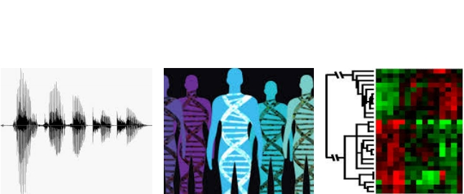

When Do We Use Machine Learning?
ML is used when:
•
•
•
•
Human expertise does not exist (navigating on Mars)
Humans can’t explain their expertise (speech recognition)
Models must be customized (personalized medicine)
Models are based on huge amounts of data (genomics)
Learning isn’t always useful:
• There is no need to “learn” to calculate payroll
Based on slide by E. Alpaydin
5

Slide 12
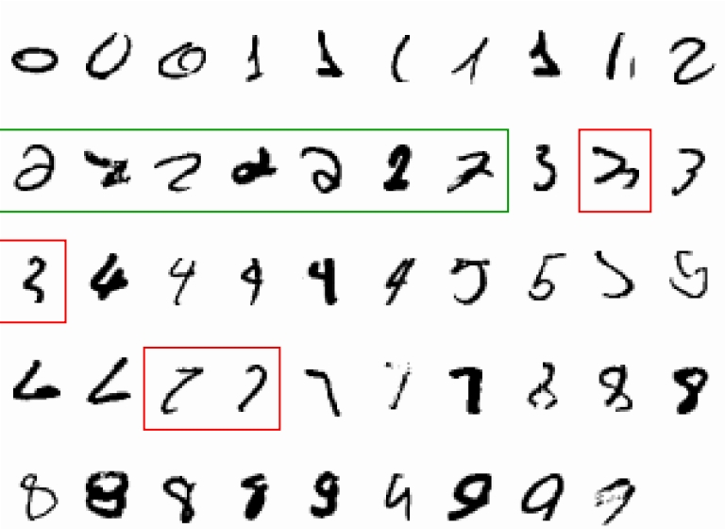
A classic example of a task that requires machine learning:
It is very hard to say what makes a 2
6
Slide credit: Geoffrey Hinton

Slide 13
Some more examples of tasks that are best
solved by using a learning algorithm
• Recognizing patterns:
– Facial identities or facial expressions
– Handwritten or spoken words
– Medical images
• Generating patterns:
– Generating images or motion sequences
• Recognizing anomalies:
– Unusual credit card transactions
– Unusual patterns of sensor readings in a nuclear power plant
• Prediction:
– Future stock prices or currency exchange rates
7
Slide credit: Geoffrey Hinton

Slide 14
Sample Applications
Web search
Computational biology
Finance
E-commerce
Space exploration
Robotics
Information extraction
Social networks
Debugging software
etc.,
•
•
•
•
•
•
•
•
•
•
8
Slide credit: Pedro Domingos

Slide 15
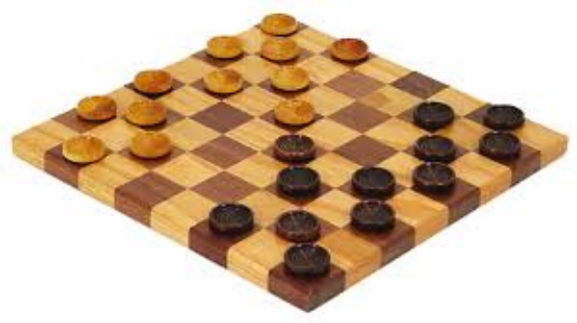
Samuel’s Checkers-Player
“Machine Learning: Field of study that gives
computers the ability to learn without being
explicitly programmed.” -Arthur Samuel (1959)
9

Slide 16
Defining the Learning Task
Improve on task T, with respect to
performance metric P, based on experience E
T: Playing checkers
P: Percentage of games won against an arbitrary opponent
E: Playing practice games against itself
T: Recognizing hand-written words
P: Percentage of words correctly classified
E: Database of human-labeled images of handwritten words
T: Driving on four-lane highways using vision sensors
P: Average distance traveled before a human-judged error
E: A sequence of images and steering commands recorded while
observing a human driver.
T: Categorize email messages as spam or legitimate.
P: Percentage of email messages correctly classified.
E: Database of emails, some with human-given labels
Slide credit: Ray Mooney
10

Slide 17
State of the Art Applications of
Machine Learning
11

Slide 18
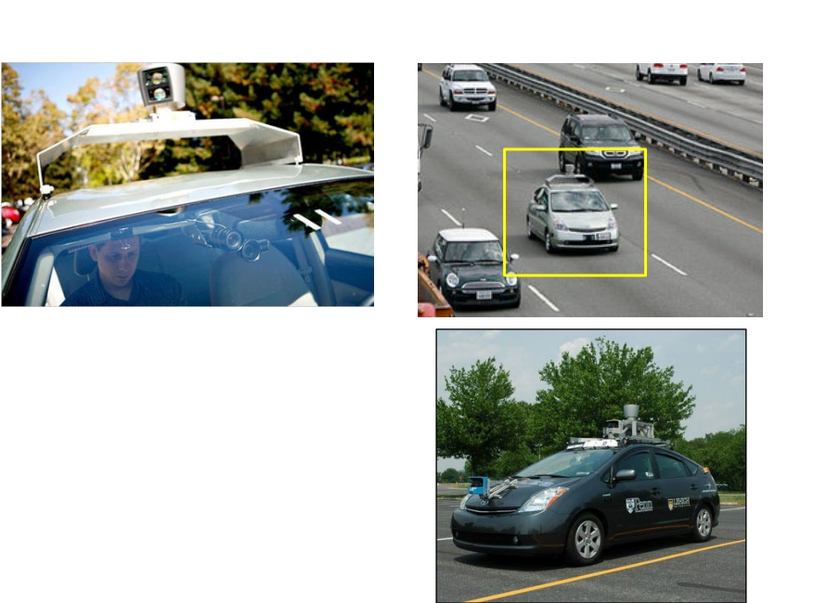
Autonomous Cars
• Nevada made it legal for autonomous cars to drive on
roads in June 2011
• In 2013, four states (Nevada, Florida, California, and
Michigan) have legalized autonomous cars
USA - Federal Automated Vehicles Policy (USDOT)
United Kingdom – Act 2018 for Autonomous cars
Source: https://en.wikipedia.org/wiki/Regulation_of_self-driving_cars
Penn’s Autonomous Car à
(Ben Franklin Racing Team)
12

Slide 19
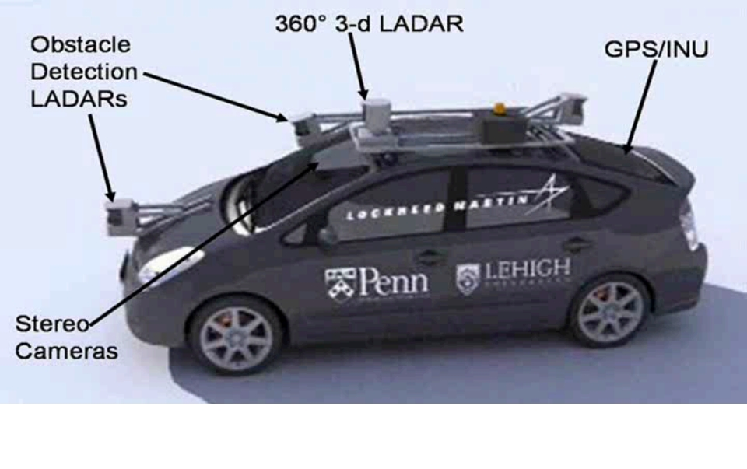
Autonomous Car Sensors
13

Slide 20
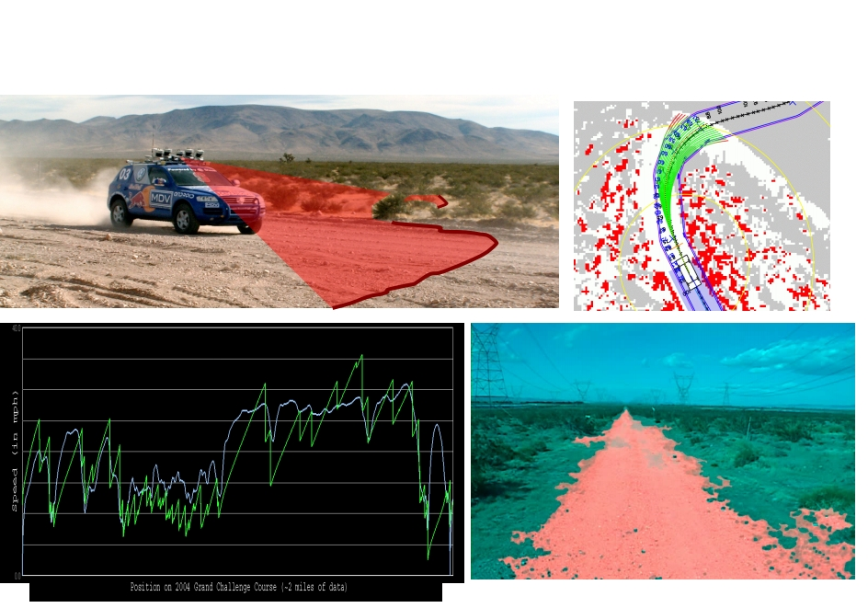
Autonomous Car Technology
Path
Planning
Laser Terrain Mapping
Learning from Human Drivers
Sebastian
Adaptive Vision
Stanley
Images and movies taken from Sebastian Thrun ’ s multimedia website.

Slide 21
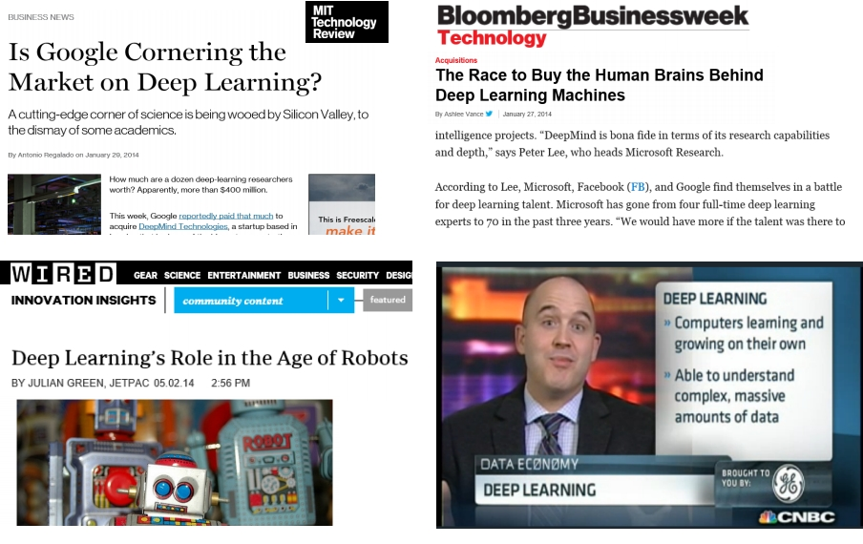
Deep Learning in the Headlines
15

Slide 22
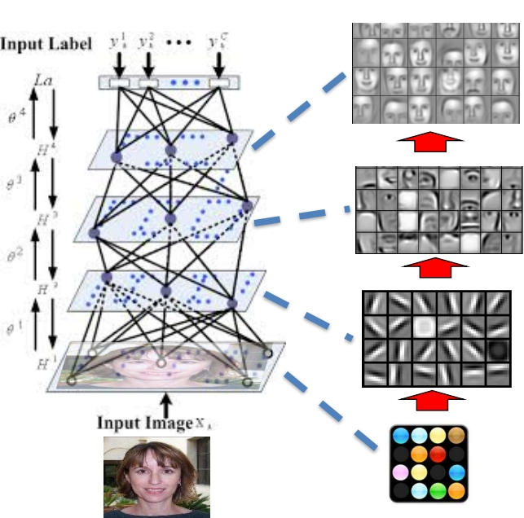
Deep Belief Net on Face Images
object models
object parts
(combination
of edges)
edges
pixels
Based on materials
by Andrew Ng
16

Slide 23
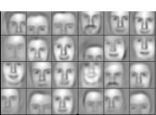
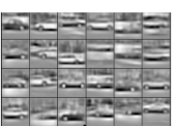
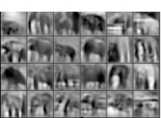
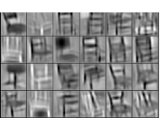
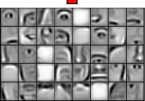
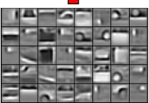
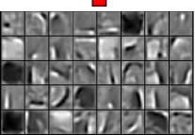
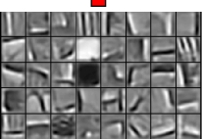
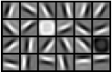

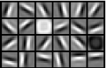
Learning of Object Parts
Examples of learned object parts from object categories
Faces
Cars
Elephants
Chairs
17
Slide credit: Andrew Ng

Slide 24
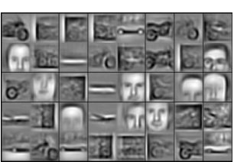
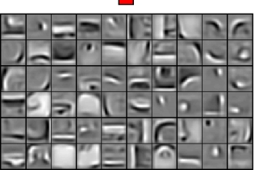
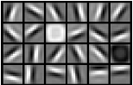
Training on Multiple Objects
Trained on 4 classes (cars, faces,
motorbikes, airplanes).
Second layer: Shared-features
and object-specific features.
Third layer: More specific
features.
18
Slide credit: Andrew Ng

Slide 25
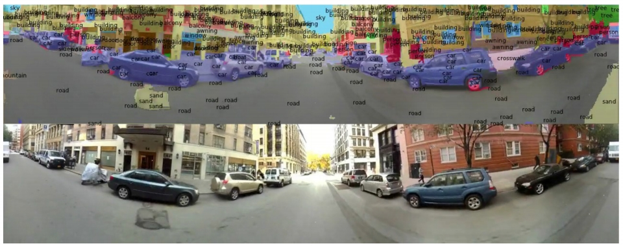
Scene Labeling via Deep Learning
[Farabet et al. ICML 2012, PAMI 2013]
19

Slide 26
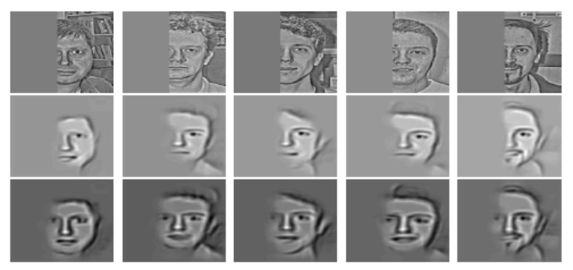
Inference from Deep Learned Models
Generating posterior samples from faces by “ filling in ” experiments
(cf. Lee and Mumford, 2003). Combine bottom-up and top-down inference.
Input images
Samples from
feedforward
Inference
(control )
Samples from
Full posterior
inference
20
Slide credit: Andrew Ng

Slide 27
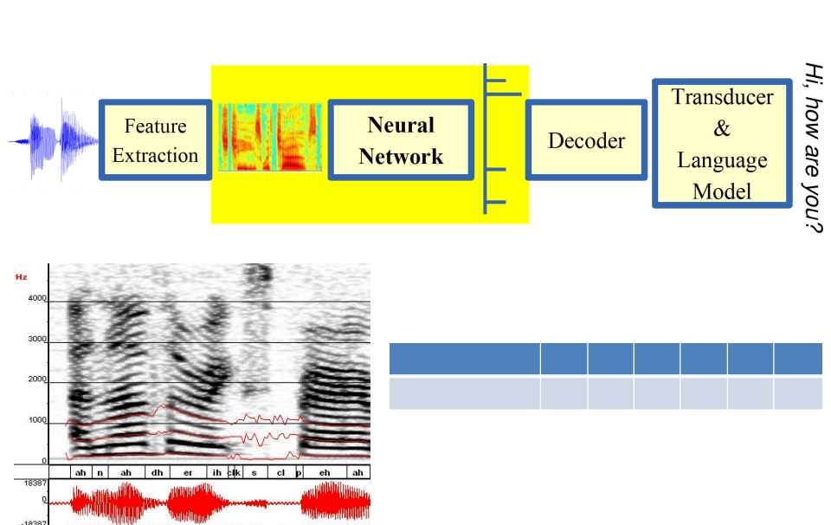
Machine Learning in
Automatic Speech Recognition
A Typical Speech Recognition System
ML used to predict phone states from the sound spectrogram
Deep learning has state-of-the-art results
# Hidden Layers
Word Error Rate %
1
16.0
2
12.8
4
11.4
8
10.9
10
11.0
12
11.1
Baseline GMM performance = 15.4%
[Zeiler et al. “On rectified linear units for speech
recognition” ICASSP 2013]
21
Notes:
Transducer converts energy from one form to another form e.g., Loud Speaker, LED, Thermometer, microphone etc.,
A spectrogram is a visual representation of the spectrum of frequencies of a signal as it varies with time. When applied to an audio signal, spectrograms are sometimes called sono graphs, voice prints, or voice grams.

Slide 28
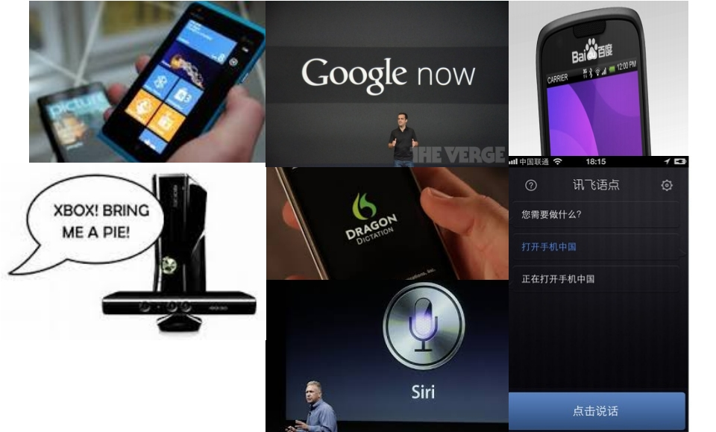
Impact of Deep Learning in Speech Technology
22
Slide credit: Li Deng, MS Research

Slide 29
Types of Learning
23

Slide 30
Types of Learning
• Supervised (inductive) learning
– Given: training data + desired outputs (labels)
• Unsupervised learning
– Given: training data (without desired outputs)
• Semi-supervised learning
– Given: training data + a few desired outputs
• Reinforcement learning
– Rewards from sequence of actions
Based on slide by Pedro Domingos
24

Slide 31
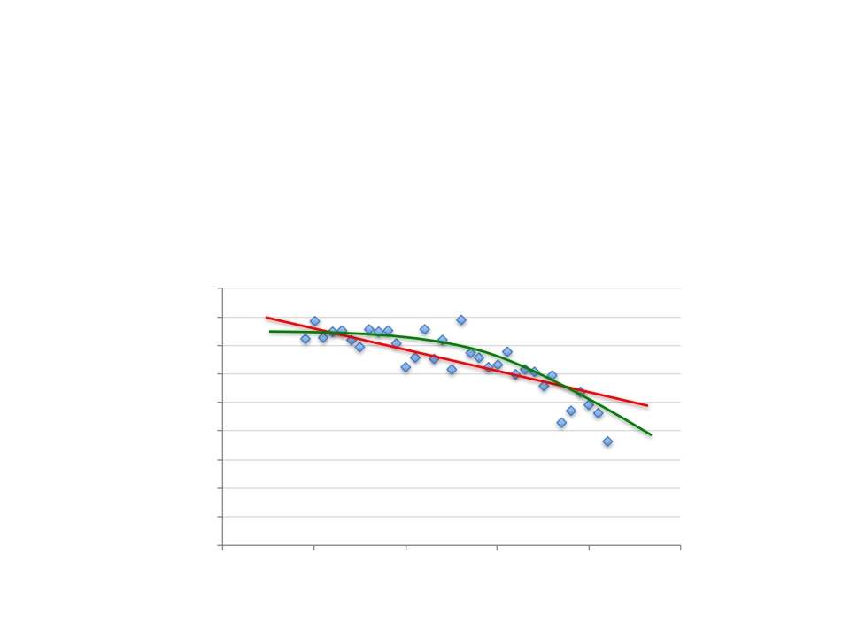
Supervised Learning: Regression
• Given ( x 1 , y 1 ), ( x 2 , y 2 ), ..., ( x n , y n )
• Learn a function f ( x ) to predict y given x
– y is real-valued == regression
9
8
7
6
5
4
3
2
1
0
September Arctic Sea Ice Extent
(1,000,000 sq km)
1970
1980
1990
2000
2010
2020
Year
Data from G. Witt. Journal of Statistics Education, Volume 21, Number 1 (2013)
26

Slide 32









Supervised Learning: Classification
• Given ( x 1 , y 1 ), ( x 2 , y 2 ), ..., ( x n , y n )
• Learn a function f ( x ) to predict y given x
– y is categorical == classification
Cancer (Malignant / Benign)
1(Malignant)
0(Benign)
Tumor Size
27
Based on example by Andrew Ng

Slide 33
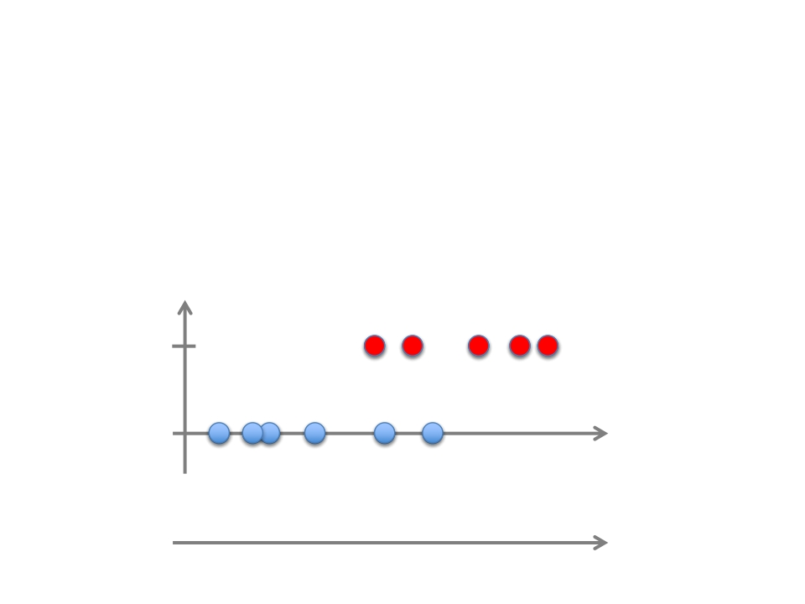
Supervised Learning: Classification
• Given ( x 1 , y 1 ), ( x 2 , y 2 ), ..., ( x n , y n )
• Learn a function f ( x ) to predict y given x
– y is categorical == classification
Cancer (Malignant / Benign)
1(Malignant)
0(Benign)
Tumor Size
Tumor Size
28
Based on example by Andrew Ng

Slide 34
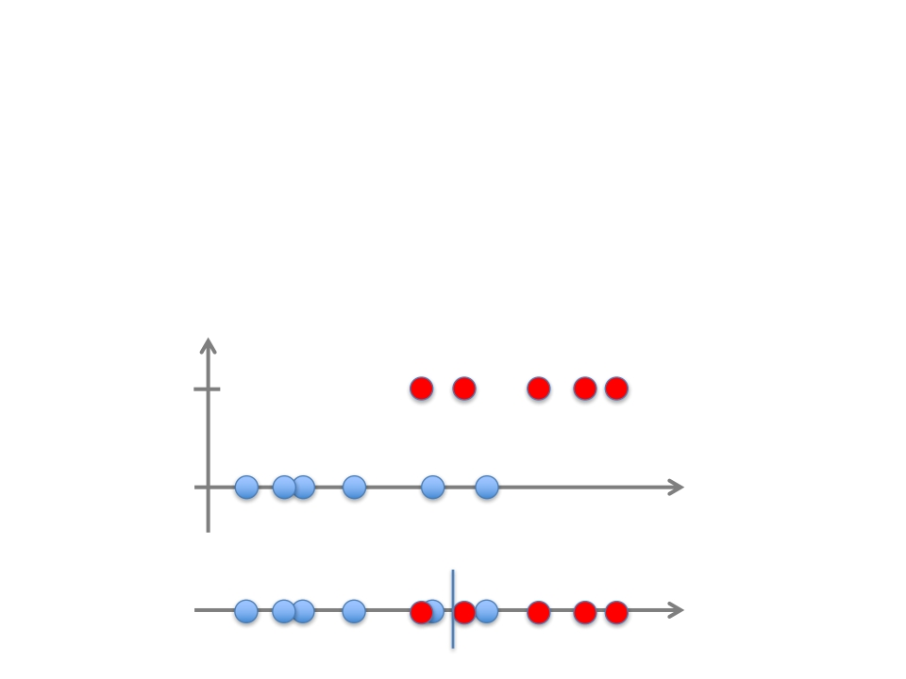
Supervised Learning: Classification
• Given ( x 1 , y 1 ), ( x 2 , y 2 ), ..., ( x n , y n )
• Learn a function f ( x ) to predict y given x
– y is categorical == classification
Cancer (Malignant / Benign)
1(Malignant)
0(Benign)
Tumor Size
Predict Benign
Predict Malignant
Tumor Size
29
Based on example by Andrew Ng

Slide 35
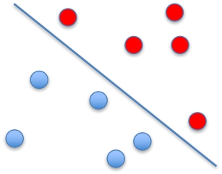
Supervised Learning
• x can be multi-dimensional
– Each dimension corresponds to an attribute
- Clump Thickness
- Uniformity of Cell Size
- Uniformity of Cell Shape
…
30
Age
Tumor Size
Based on example by Andrew Ng

Slide 36
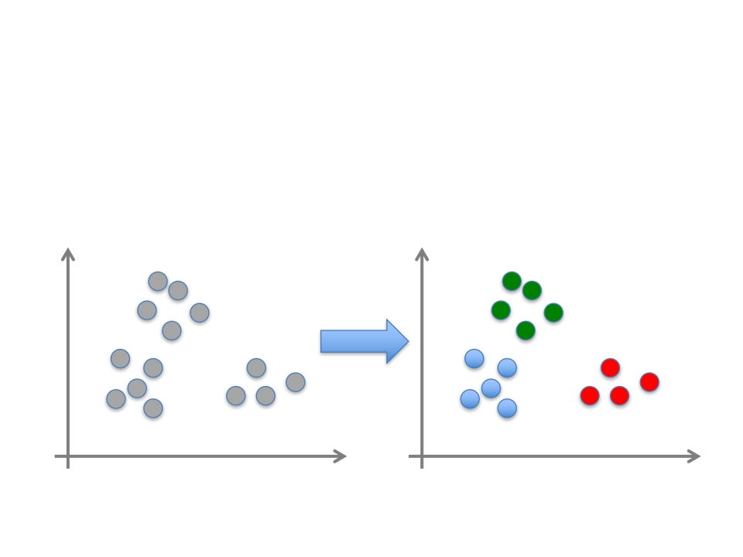
Unsupervised Learning
• Given x 1 , x 2 , ..., x n (without labels)
• Output hidden structure behind the x ’s
– E.g., clustering
31

Slide 37
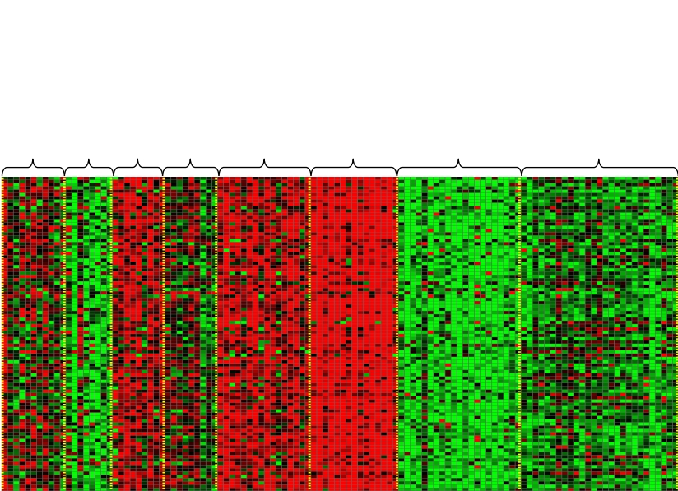
Unsupervised Learning
Genomics application: group individuals by genetic similarity
Genes
Individuals
32
[Source: Daphne Koller]

Slide 38
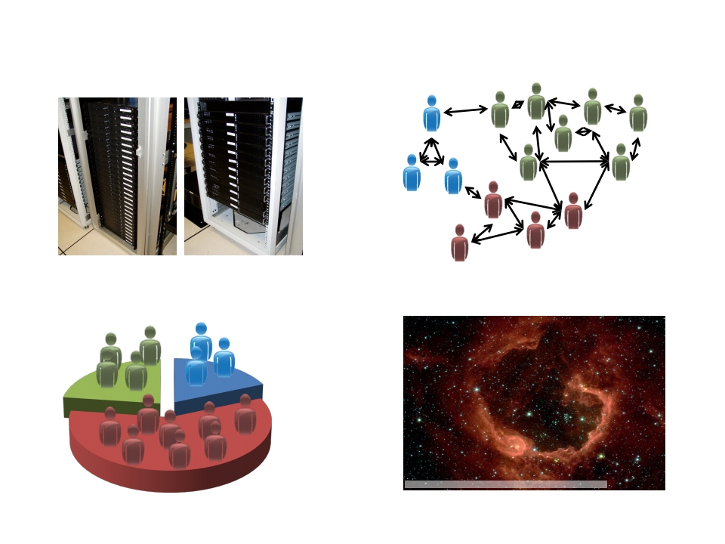
Unsupervised Learning
Organize computing clusters
Social network analysis
Image credit: NASA/JPL-Caltech/E. Churchwell (Univ. of Wisconsin, Madison)
Astronomical data analysis
Market segmentation
Slide credit: Andrew Ng
33

Slide 39
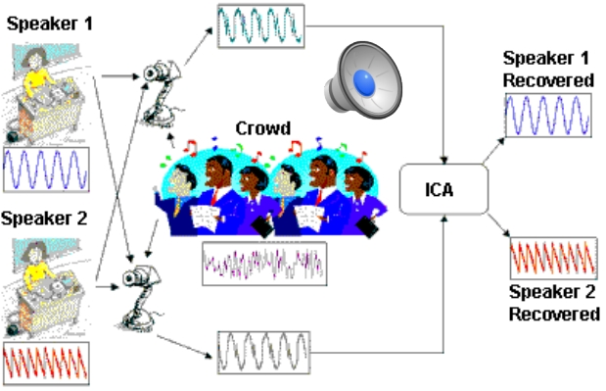

Unsupervised Learning
• Independent component analysis – separate a
combined signal into its original sources
34
Image credit: statsoft.com Audio from http://www.ism.ac.jp/~shiro/research/blindsep.html
Notes:
Independent Component Analysis (ICA) is a statistical method used to identify hidden factors of random variables. It is a linear generative model which assumes the observed variables are a linear mixture of unknown non Gaussian and mutually independent variables.

Slide 40
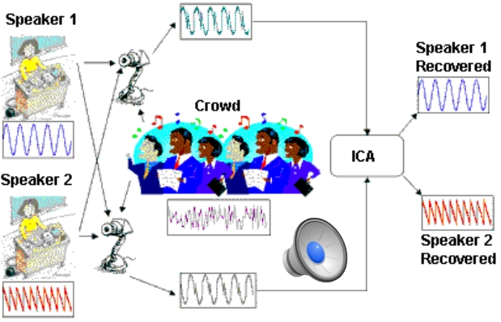


Unsupervised Learning
• Independent component analysis – separate a
combined signal into its original sources
35
Image credit: statsoft.com Audio from http://www.ism.ac.jp/~shiro/research/blindsep.html

Slide 41
Reinforcement Learning
• Given a sequence of states and actions with
(delayed) rewards, output a policy
– Policy is a mapping from states à actions that
tells you what to do in a given state
• Examples:
– Credit assignment problem
– Game playing
– Robot in a maze
– Balance a pole on your hand
36
Notes:
Delayed Rewards: At the basic level, you have biological drives, hunger in this example.
Hunger is bad, by definition.
Your brain notices that if you don’t eat, then you have hunger later. So not eating is bad.
Your brain notices that if you have an empty fridge, then you cannot eat later. So having an empty fridge is bad.
Your brain notices that if you have a half-empty fridge, then you have an empty fridge later. So having a half-empty fridge is bad.
Your brain notices that if you buy stuff in the supermarket, then you get a fuller fridge. Sa buying stuff in the supermarket is good.
Your brain notices that if you don’t have money, then you cannot buy stuff in the supermarket. So having money is good.
Your brain notices that if you have a job, then you get money. So having a job is good.
The conclusion of this is that from the very basic biological drive of hunger you build an heuristic that says having a job is good. It takes a few levels of abstraction. This is how humans manage delayed gratification.
Reinforcement learning is about discriminating between what is good and bad according to a metric. (And this is used to direct actions) By doing this, you create intermediary representations that are in the end collapsed into a single dimension metric of reward.

Slide 42
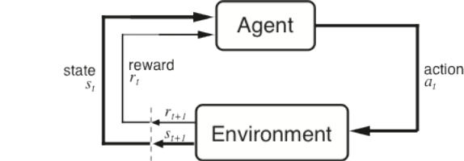
The Agent-Environment Interface
Agent and environment interact at discrete time steps : t = 0, 1, 2, K
Agent observes state at step t : s t ∈ S
produces action at step t : a t ∈ A ( s t )
gets resulting reward :
r t + 1 ∈ ℜ
and resulting next state : s t + 1
r t +1
r t +2
r t +3 s t +3
...
s t a t
s t +1
s t +2
...
a t +3
a t +1
a t +2
37
Slide credit: Sutton & Barto

Slide 43
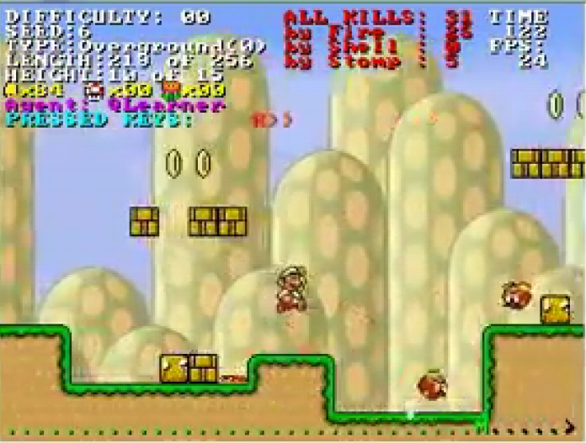
Reinforcement Learning
https://www.youtube.com/watch?v=4cgWya-wjgY
38

Slide 44
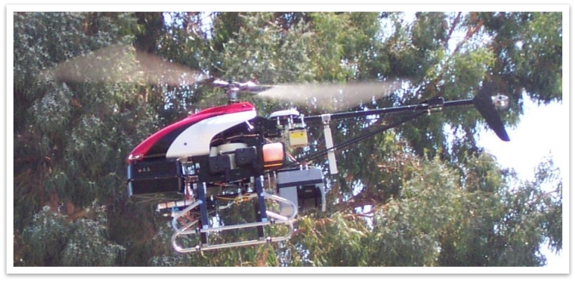
Inverse Reinforcement Learning
• Learn policy from user demonstrations
Stanford Autonomous Helicopter
http://heli.stanford.edu/
https://www.youtube.com/watch?v=VCdxqn0fcnE
39
Notes:
Inverse reinforcement learning (IRL) is a specific form of learning from demonstration that attempts to estimate the reward function of a Markov decision process from examples provided by the teacher. The reward function is often considered the most succinct description of a task.

Slide 45
Framing a Learning Problem
40

Slide 46

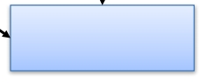
Designing a Learning System
• Choose the training experience
• Choose exactly what is to be learned
– i.e. the target function
• Choose how to represent the target function
• Choose a learning algorithm to infer the target
function from the experience
Training data
Testing data
Learner
Knowledge
Performance
Element
Environment/
Experience
Based on slide by Ray Mooney
41

Slide 47
Training vs. Test Distribution
• We generally assume that the training and
test examples are independently drawn from
the same overall distribution of data
– We call this “i.i.d” which stands for “independent
and identically distributed”
• If examples are not independent, requires
collective classification
• If test distribution is different, requires
transfer learning
42
Slide credit: Ray Mooney

Slide 48
ML in a Nutshell
• Tens of thousands of machine learning
algorithms
– Hundreds new every year
• Every ML algorithm has three components:
– Representation
– Optimization
– Evaluation
43
Slide credit: Pedro Domingos

Slide 49
Various Function Representations
• Numerical functions
– Linear regression
– Neural networks
– Support vector machines
• Symbolic functions
– Decision trees
– Rules in propositional logic
– Rules in first-order predicate logic
• Instance-based functions
– Nearest-neighbor
– Case-based
• Probabilistic Graphical Models
– Naïve Bayes
–
–
–
–
Bayesian networks
Hidden-Markov Models (HMMs)
Probabilistic Context Free Grammars (PCFGs)
Markov networks
44
Slide credit: Ray Mooney

Slide 50
Various Search/Optimization
Algorithms
• Gradient descent
– Perceptron
– Backpropagation
• Dynamic Programming
– HMM Learning
– PCFG Learning
• Divide and Conquer
– Decision tree induction
– Rule learning
• Evolutionary Computation
– Genetic Algorithms (GAs)
– Genetic Programming (GP)
– Neuro-evolution
Slide credit: Ray Mooney
45

Slide 51
Evaluation
Accuracy
Precision and recall
Squared error
Likelihood
Posterior probability
Cost / Utility
Margin
Entropy
K-L divergence
etc.
•
•
•
•
•
•
•
•
•
•
47
Slide credit: Pedro Domingos

Slide 52

ML in Practice
Understand domain, prior knowledge, and goals
Data integration, selection, cleaning, pre-processing, etc.
Learn models
Interpret results
Consolidate and deploy discovered knowledge
•
•
•
•
•
Loop
48
Based on a slide by Pedro Domingos

Slide 53
Lessons Learned about Learning
• Learning can be viewed as using direct or indirect
experience to approximate a chosen target function.
• Function approximation can be viewed as a search
through a space of hypotheses (representations of
functions) for one that best fits a set of training data.
• Different learning methods assume different
hypothesis spaces (representation languages) and/or
employ different search techniques.
49
Slide credit: Ray Mooney

Slide 54
A Brief History of
Machine Learning
50

Slide 55
History of Machine Learning
• 1950s
– Samuel ’ s checker player
– Selfridge ’ s Pandemonium
• 1960s:
– Neural networks: Perceptron
– Pattern recognition
–
–
Learning in the limit theory
Minsky and Papert prove limitations of Perceptron
• 1970s:
– Symbolic concept induction
–
–
–
–
–
–
Winston ’ s arch learner
Expert systems and the knowledge acquisition bottleneck
Quinlan ’ s ID3
Michalski ’ s AQ and soybean diagnosis
Scientific discovery with BACON
Mathematical discovery with AM
51
Slide credit: Ray Mooney

Slide 56
History of Machine Learning (cont.)
• 1980s:
– Advanced decision tree and rule learning
–
–
–
–
–
–
–
–
Explanation-based Learning (EBL)
Learning and planning and problem solving
Utility problem
Analogy
Cognitive architectures
Resurgence of neural networks (connectionism, backpropagation)
Valiant ’ s PAC Learning Theory
Focus on experimental methodology
• 1990s
– Data mining
– Adaptive software agents and web applications
–
–
–
–
–
Text learning
Reinforcement learning (RL)
Inductive Logic Programming (ILP)
Ensembles: Bagging, Boosting, and Stacking
Bayes Net learning
52
Slide credit: Ray Mooney

Slide 57
History of Machine Learning (cont.)
• 2000s
– Support vector machines & kernel methods
– Graphical models
– Statistical relational learning
– Transfer learning
– Sequence labeling
– Collective classification and structured outputs
– Computer Systems Applications ( Compilers, Debugging, Graphics, Security)
– E-mail management
– Personalized assistants that learn
– Learning in robotics and vision
• 2010s
– Deep learning systems
– Learning for big data
– Bayesian methods
– Multi-task & lifelong learning
– Applications to vision, speech, social networks, learning to read, etc.
53
Based on slide by Ray Mooney

